Slide 1


Towards Evidence Codes for Metabolite Identification
Daniel Schober

Slide 2
Contents
Project setting
Metabolite Identification
What it means to assign evidences to compounds
Efforts to re-use
Their drawbacks
Our Use Case
Mass Spec based identification of root exudates
Inhouse paper by N. Strehmel et al.
MIECO: Metabolite Identification Evidence Ontology
Metabolite Identification evidence patterns
Annotation of use case metabolites
Outlook & Conclusions

Slide 3

Project environment
H2020 EU Project
Phenome and Metabolome aNalysis
e-Infrastructure
Analysis of clinical metabolomics data
Clouds & workflows
Leveraging on data standards
Communicate results
Query data

Slide 4
GOAL
A standardized way to assert
identified molecules to Samples
Provide evidence indicators
Based on assay methods
Allow data quality to be judged
Allow to query data based on reliability
“What’s wrong with feature listing in papers ?”

Slide 5
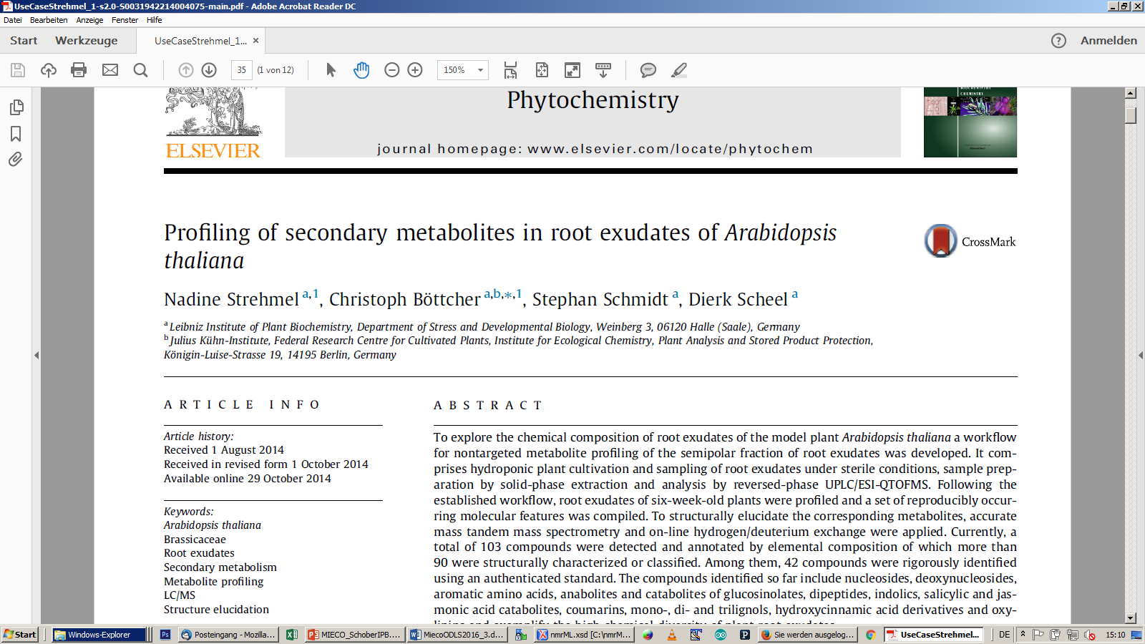
Inhouse paper Use Case
Which ones ?
How to query for these ?
What means rigorously ?

Slide 6
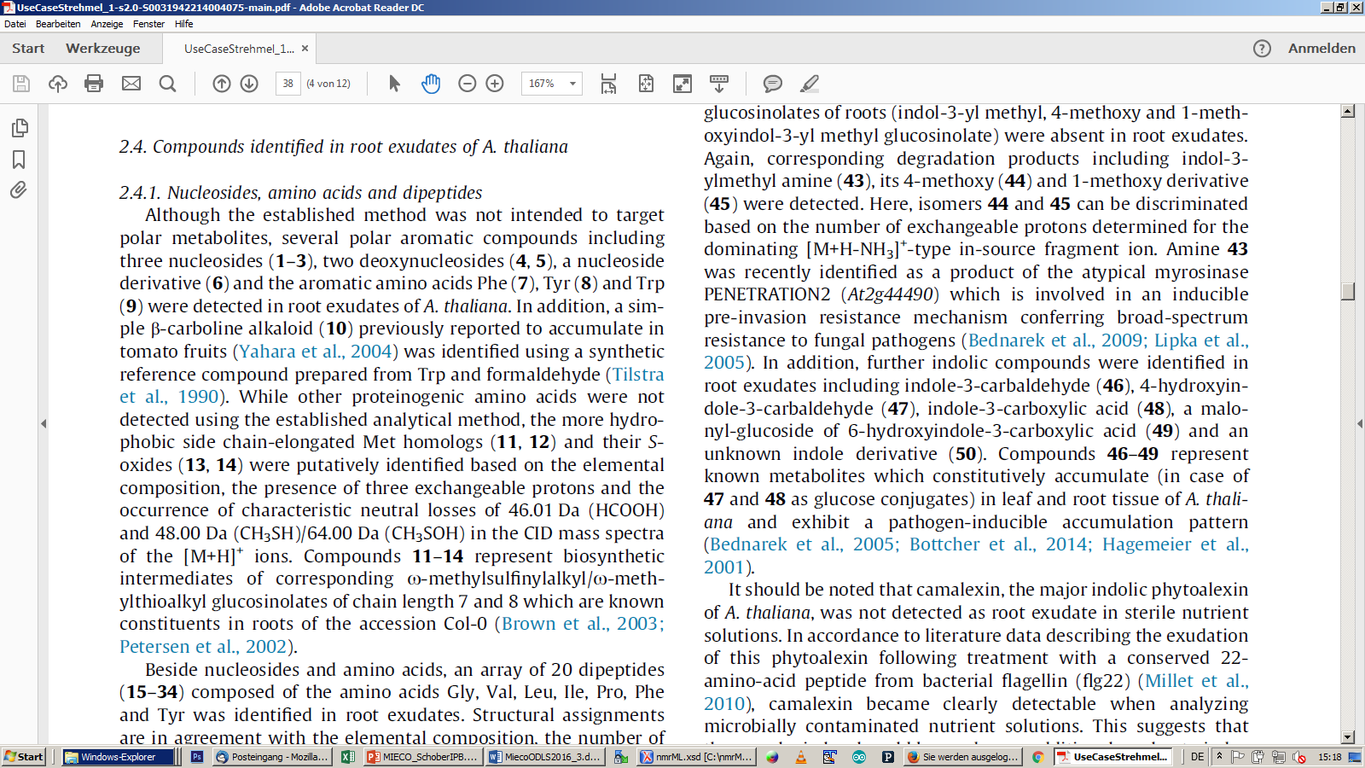
Written Text
Freetext verbalization
Human readable, but …
Unstandardized
Varies greatly
between studies
between users
Implicit knowledge
not accessible to computers
#2, Guanosine = Nucleoside

Slide 7
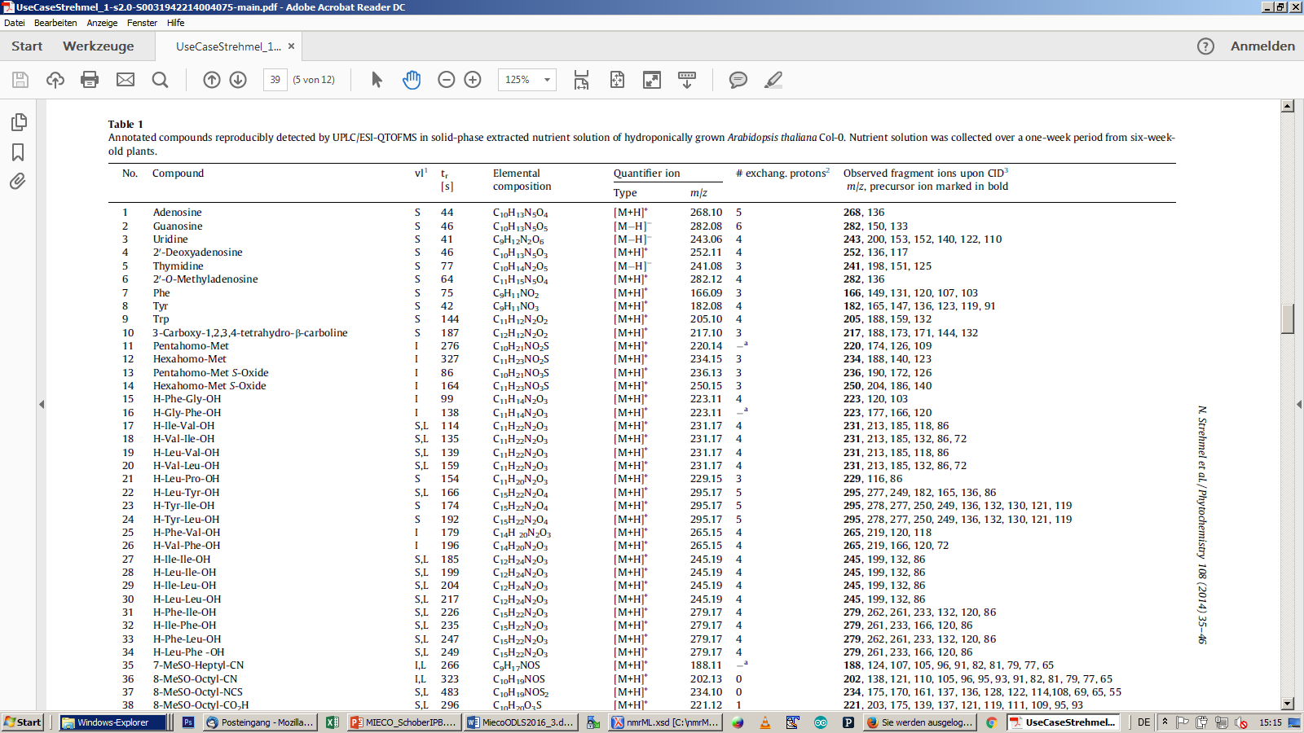
Coarse grained verification indicator
(Secure, Inferred, Literature)
No Identification audit trail to judge data
Hinders quality assurance
trust & evaluation
drives decisions to re-use data
Tables
Hard to parse
Hard to query
Not computer- accessible

Slide 8
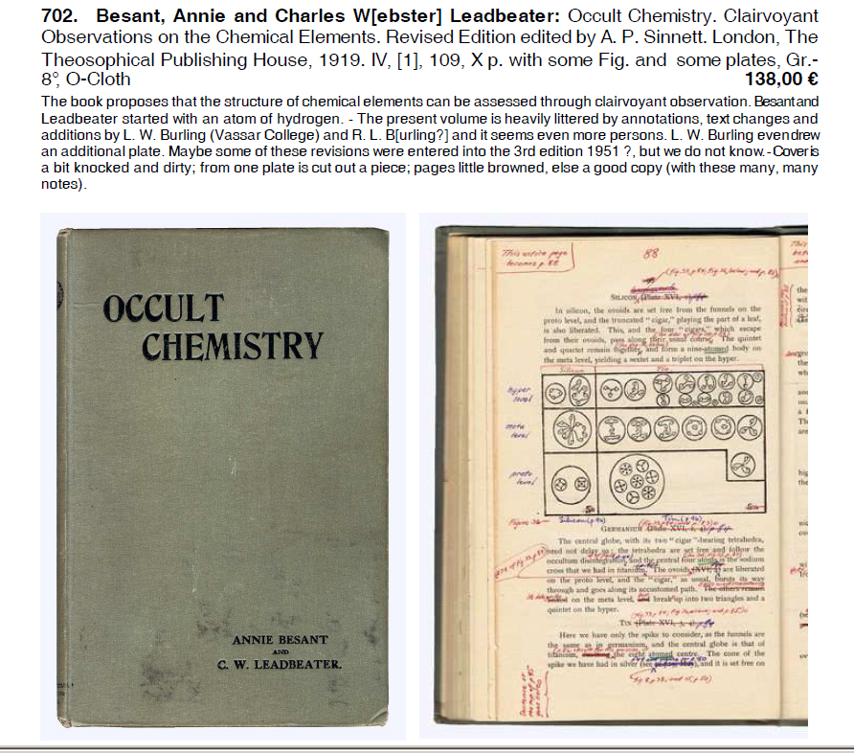

Slide 9
4 Level Scheme Sumner et al 2007 , MSI
Rather arbitrary
Level 1: Confident Identification based on two orthogonal evidences using defined reference standards measured under identical analytical conditions.
Level 2: Putative Identification based on similar physicochemical properties or library spectra similarities (no authentic reference standard).
Level 3: Putative Identification of Compound-Class i.e. classification based on similar physicochemical properties or spectral similarity with a compound class.
Level 4: Known Unknowns that are unidentified, yet can be differentiated and quantified based on spectral data.
Sumner L.W., Amberg A., Barrett D., Beale M. et al. (2007), Proposed minimum reporting standards for chemical analysis. Metabolomics. 2007;3(3):211–221. doi: 10.1007/s11306-007-0082-2.
When is something ‘similar’ ?
When is something a class ?

Slide 10
Drawbacks of simple schemes
Lack of granularity
4 Levels are too coarse grained
Lack of expressiveness
Not enough search attributes provided
Assay Evidences not named
Lack of standards back-up
Absence of ontology

Slide 11
SEE: Semantic EvidencE ontology
Bölling C., Weidlich M., Holzhütter H.G. (2014), SEE: structured representation of scientific evidence in the biomedical domain using Semantic Web techniques. J Biomed Semantics; 5(Suppl 1): S1. doi: 10.1186/2041-1480-5-S1-S1
Generic Approach
Domain independent
‘Evidence’ in terms of argumentative structure
Applied Description Logics
Brilliantly formal
Computer accessible semantics
Automatic Reasoning

Slide 12
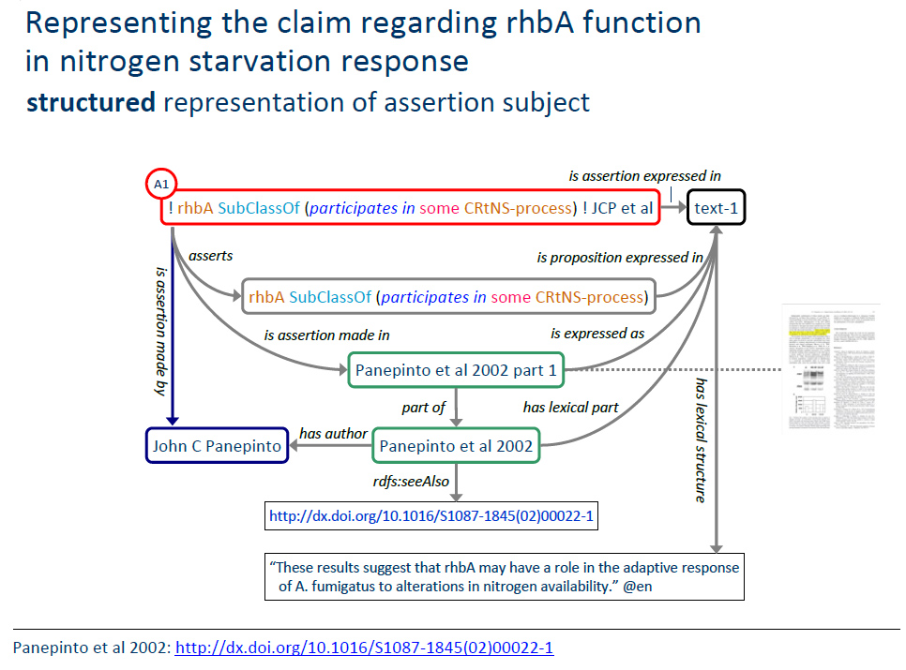
“May have a role ”→existential axiom ?

Slide 13
Drawbacks of generic Schemes
Heavy Description Logics
Axiomatisation
Relying on extensive annotations
FOL expertise required
High entry hurdle & hard learning threshold
Complexity shielding not yet available to users
No assay methods coverage
Sparse domain coverage
Due to slow development cycles

Slide 14
Our Approach
Annotate feature assignments with ontology terms
MIECO: Metabolite Identification Evidence Code Ontology
Low entry hurdle for bio-community
Easy to adopt & use
Clearly delineated subject domain
Target feature annotation in metabolomics assays
MS, NMR, IR, UV Spec methods
Pragmatic middle-way
Usability & Intuitivity vs.
Expressivity & complexity
Retain mappings to earlier schemes

Slide 15
Annotation Term Pattern
Samples are annotated with …
Annotation of MolecularStructure by
Assay used in
AssertionType
for example
Identification of Guanosine by
‘LCMS fragmentation pattern’ used in
‘Similarity assertion to authentic reference standard’

Slide 16
Basic ontology modules
What branches are required in the ontology ?
What are basic modules describe MI evidence ?

Slide 17
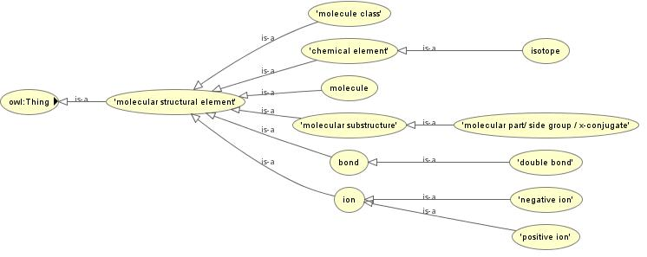
Taxonomy of Molecular Structures
MolecularStructureElement
http://phenomenal-h2020.eu/home/workpackages/wp8-data-provenance-compliance-and-integrity/
memberOf
partOf

Slide 18
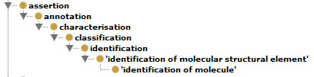
Taxonomy of Assertions
AssertionType

Slide 19
Taxonomy of AssayCharacteristics
Assay
Assay Types
MS
NMR
IR Spec
UV Spec
Assay Properties
Mass Spec Properties
MS, MS2,
RT,
Isotope data
adduct data
quantifier Ions

Slide 20
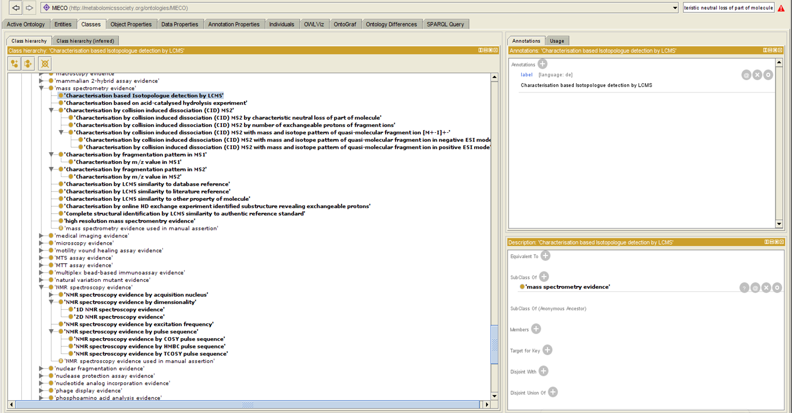
MIECO re-using ECO Protégé GUI
MIECO starts, where ECO ends
Chibucos M.C., Mungall C.J., Balakrishnan R., Christie K.R., Huntley R.P., White O., Blake J.A., Lewis S.E., Giglio M., (2014), Standardized description of scientific evidence using the Evidence Ontology (ECO). Database. 2014, 2014: bau075-10.1093/database/bau075, http://www.ncbi.nlm.nih.gov/pmc/articles/PMC4105709

Slide 21
MS Feature annotation via Standardized MIECO terms
LCMS Feature#| | 2 | 20 | 50 | 100
Assignment | Guanosine | H-Val-Leu-OH | Unknown Indole derivate | Unknown
MIECO Annotation, 1:n | MIECO_0000001:Complete structural identification by LCMS similarity to authentic reference standard | MIECO_0000001, MIECO_0000002: Characterisation by LCMS similarity to literature reference | MIECO_0000097:Classification based on RT and m/z value in MS2 | MIECO_0000098:Unknown assignment based on RT and m/z value in MS2
Verification Level, VL | S | S,L | I | -
Sumner 2007 | Level1 | Level1 | Level3 | Level4
Elem.Comp. | C₁₀H₁₃N₅O₅ | C₁₁H₂₂N₂O₃ | C₁₀H₉NO₃ | C₂₀H₂₈O₁₁
RT[s] | 46 | 159 | 391 | 234
#Exchange Protons | 6 | 4 | n/a | 6
Precursor. Ion Type | [M-H]⁻ | [M+H]⁺ | [M+H]⁺ | [M-H]⁻
m/z | 282.08 | 231.17 | 192.07 | 443.15
MS² fragments | 150,133 | 213,185,132,86,72 | 177, 174, 161, 159, 148, 133, 132, 117,116, 105, 104 | 291, 151, 145, 125, 107, 101
mapping
mapping

Slide 22
Annotating features on a granular level
Annotating each evidence contributor (ms assay property)
Guanosine example annotated with MIECO terms
Mass Spec Property | Value | MIECO annotation
Elem.Comp. | C₁₀H₁₃N₅O₅ | ‘MIECO_0000094: Characterisation by sum formula’
RT[s] | 46 | ‘MIECO_0000028: Characterisation by RI similarity’
#Exchange Protons | 6 | ‘MIECO_0000012: Characterisation by online HD exchange experiment identified substructure revealing exchangeable protons’
Precursor. Ion Type | [M-H]⁻ | ‘MIECO_0000016: Characterisation by collision induced dissociation (CID) MS2 with mass and isotope pattern of quasi-molecular fragment ion in negative ESI mode’
m/z | 282.08 | ‘MIECO_0000009: Characterisation by m/z value in MS1’
MS² fragments | 150,133 | ‘MIECO_0000010: Characterisation by fragmentation pattern in MS2’

Slide 23
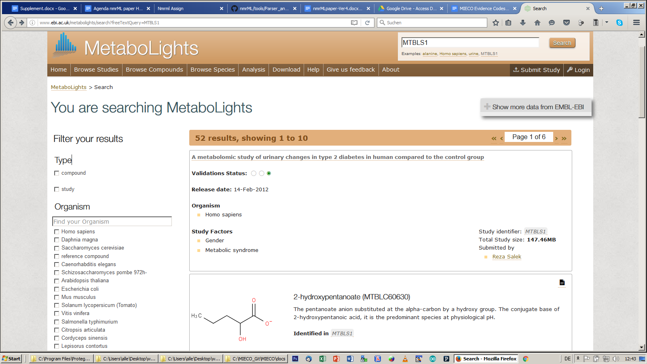
MIECO in MetaboLights ?
Evidence
MIECO_0000001:Complete structural identification by LCMS similarity to authentic reference standard

Slide 24
Next steps
Gather feedback at ODLS 2016 (IPB hosted)
Invite Metabolite Identification Task Group
Expand MIECO coverage, e.g. NMR
Overhaul structure
Re-use ontologies for further aspects
Chemical Naming, Samples, Conditions, …
Ease annotation via supporting tools
Allow quantitative quality scores
numeric evaluation via evidence-thresholds
Recommend to publishers & repositories
Springer Metabolomics Journal
MetaboLights database

Slide 25
Conclusion
MIECO.owl first draft
Simple intuitive annotation
Domain optimized for metabolomics assays
Granular enough to capture assay characteristics
Standardized & queryable
Downward compatible to MSI scheme

Slide 26
Acknowledgements
PhenoMeNal is funded by European Commission's Horizon2020 programme, grant agreement number 654241
Metabolomics Society: Metabolite Identification Task Group
Baltimore ECO workshop participants
Nadine Strehmel, Resa Salek, Christoph Ruttkies

Slide 27
Thank you!
dschober@ipb-halle.de

Slide 28
Resources
Ontology on Git
https://github.com/DSchober/MIECO
Documentation on Gdoc
https://docs.google.com/document/d/1JHw7FntqtntZV0qoWsFmcOLcHlM2wv4jt4-ccLUgZNU/edit#
ODLS paper
to appear in IMISE Reports 2016

Slide 29
Confidence in Metabolite Identification statements
Freetext verbalisation of evidence
varies greatly between studies / users
unstandardized
difficult to communicate
not computer accessible
No Identification audit trail to judge data
Hinders quality assurance
Foundation for trust & evaluation
Drives decisions to re-use data

Slide 30
Existing Standards
EU Directive 96/23/EC concerning performance of analytical methods & the interpretation of results (C(2002) 3044)
A hundred page PDF
Not formalized/computer readable
No accompanying Data standard
Too complex → provide little practical utility

Slide 31
5 Level scheme
Schymansky etal 2014, in expansion to Sumner et al. 2007

Slide 32
Domain specific yet simple, nonformal schemes
Sumner L.W., Amberg A., Barrett D., Beale M. et al. (2007), Proposed minimum reporting standards for chemical analysis. Metabolomics. 2007;3(3):211–221. doi: 10.1007/s11306-007-0082-2.
Schymanski, E. L., Jeon, J., Gulde, R., Fenner, K., Ruff, M., Singer,H. P., et al. (2014), Identifying small molecules via high resolution mass spectrometry: communicating confidence. Environmental Science and Technology, 48 (4), 2097–2098. doi:10.1021/es5002105
Creek, D., Dunn, W., Fiehn, O., Griffin, J., Hall, R., Lei, Z., Mistrik, R., Neumann, S., Schymanski, E. L., Sumner, L., et al. (2014), Metabolite identification: are you sure? And how do your peers gauge your confidence? Metabolomics, 10, pp. 350–353
Sumner L, Lei Z, Nikolau BJ, Saito K, Roessner U, Trengove R (2014): Proposed quantitative and alphanumeric metabolite identification metrics. Metabolomics 10:1047–1049. doi:10.1007/s11306-014-0739-6.

Slide 33
Generic, yet complex Formal-ontologic approaches
Chibucos M.C., Mungall C.J., Balakrishnan R., Christie K.R., Huntley R.P., White O., Blake J.A., Lewis S.E., Giglio M., (2014), Standardized description of scientific evidence using the Evidence Ontology (ECO). Database. 2014, 2014: bau075-10.1093/database/bau075, http://www.ncbi.nlm.nih.gov/pmc/articles/PMC4105709
Bölling C., Weidlich M., Holzhütter H.G. (2014), SEE: structured representation of scientific evidence in the biomedical domain using Semantic Web techniques. J Biomed Semantics; 5(Suppl 1): S1. doi: 10.1186/2041-1480-5-S1-S1 http://www.jbiomedsem.com/content/5/S1/S1
…

Slide 34
Pattern elements
Assertion(Annotation)/
Characterisation
Classification
Identification
OF...
Molecular structural element
molecule
molecular class
molecular substructure
molecular part/ side group / x-conjugate
element
Isotope
BY...
Assay Outcomes (from Schymanski)
MS, MS2,
LC/RT,
Reference Standard, Library MS2, Experimental Data(???), Isotope data (nahe mz values)
adduct data (entferntere <mz values)
quantifier Ions
USING…
Assertion methods:
by Identity
by similarity
by composition
by author inference
by author statement
by literature mention
by library mention

Slide 35
MetSoc Ident Task force
Metabolomics Society: Metabolite Identification Task Group
Objective
update 4 Level reporting standard by adding increased granularity on instruments, data & bioinformatics resources

Slide 36
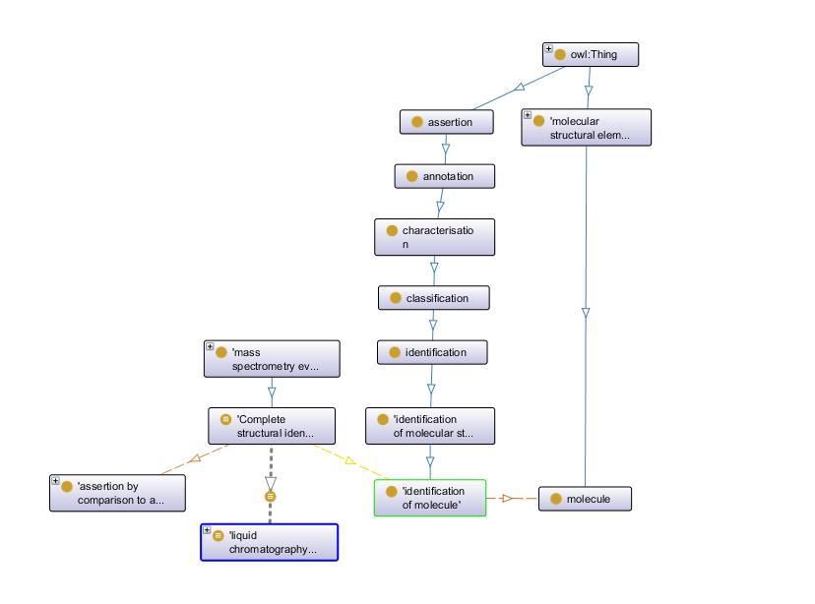

Slide 37
Import & X-Refs
Multiple Options
Mere ID Referencing
E.G. Full Import, usage and import removal
MIREOT
Owl:import
http://labs.mondeca.com/protolov/

Slide 38
Chebi/ont https://www.ebi.ac.uk/chebi/userManualForward.do;jsessionid=CCA5DEB227EC2F848F7A8DDF3D4D36DF?printerFriendlyView=true#Parents%20and%20Children%20View
Alle Einträge werden wie folgt mit einem Sterne-System eingestuft:
3 Sterne: Die Entität wurde manuell durch das ChEBI Team annotiert.
2 Sterne: Die Entität wurde manuell durch das ChEMBL Projekt oder durch einen ChEBI Einreicher annotiert.
1 Stern: Die Entität stellt einen vorläufigen Eintrag dar, welcher automatisch von einer Datenquelle geladen wurde aber nicht manuell annotiert wurde.
0 Stern: Die Abwesenheit von Sternen bedeutet, dass der Eintrag entweder gelöscht wurde oder obsolet ist.
Aber auch
5.4 Status
Der Status eines Eintrags oder einer Beziehung wird in der denormalisierten Baumansicht wie folgt dargestellt:
Kontrolliert
Einträge und Beziehungen welche von den Kuratoren eingehend überprüft wurden sind in der Baumansicht blau gefärbt.
Nicht kontrolliert
Einträge und Beziehungen mit nur vorläufigem Status sind in der Baumansicht grau gefärbt. Bei solchen Einträgen und Beziehungen sollte stets bedacht werden, dass sie noch nicht von einem Kurator kontrolliert wurden. Wenn über die Baumansicht auf sie zugegriffen wird, tragen solche Einträge zur Warnung die Überschrift "Preliminary ChEBI Entry".

Slide 39
Autogenerate Evidence Codes from standardized data ?
Text mining to derive ECOs from paper methods sec
or ideally formal future workflow specifications
Transition into Quantitative background model for numeric evaluation
i.e. allowing to set evidence thresholds for quality analysis

Slide 40
Overview of PhenoMeNal Use Cases
Use Case | Partner | Cohort Size | Assays | Workflow | Implementation
MESA | ICL | 4,000 | NMR, LC/MS | NMR: calibration, alignment, normalisation, statistics MS: Data conversion, feature detection, alignment, deconvolution, QC filtering, normalisation, batch correction | Matlab, Octave, R
CoLaus | SIB | 6,733 | NMR, Genotyping | NMR processing, MetaboMatching (Genotype correlation) | Octave
Uppsala | UU | 120 | LC/MS | Data conversion, feature detection, alignment, blank removal, feature selection | OpenMS
MetaboHUB | CEA | 183 | LC/MS | Data conversion, feature detection, alignment, univariate and multivariate statistics | R
¹³C tracer cell line | UB | -- | GC/MS | Data import, Natural Isotope abundance correction, Label enrichment, SBML | R, Python

Slide 41
To set the Frame
A survey of data provenance in e-scienceYL Simmhan, B Plale, D Gannon
ACM Sigmod Record 34 (3), 31-36

Slide 42
5 Level scheme
Schymansky, in expansion to Sumner

Slide 43
http://de.slideshare.net/egonw/metware
Egon Willighagens old approach.
My Gdoc at
https://docs.google.com/document/d/1JHw7FntqtntZV0qoWsFmcOLcHlM2wv4jt4-ccLUgZNU/edit#

Slide 44
Root exudate UseCase MTBLS160
http://www.ebi.ac.uk/metabolights/reviewerLgTnoHUrFb
Or use old
Strehmel N, Bottcher C, Schmidt S, Scheel D (2014) Profiling of secondary metabolites in root exudates of Arabidopsis thaliana. Phytochemistry 108:35–46CrossRefPubMed

Slide 45
Recently WP 8 participants have started looking into an ontology-based metabolite identification and evidence scheme based on Sumner et al (2014) and the Evidence Code Ontology (http://www.evidenceontology.org/), which will be a handy asset in judging data provenance and reliability of identification assertions in the future, i.e. allowing to set confidence threasholds for search and retrieval tasks.
Sumner L, Lei Z, Nikolau BJ, Saito K, Roessner U, Trengove R (2014): Proposed quantitative and alphanumeric metabolite identification metrics. Metabolomics 10:1047–1049. doi:10.1007/s11306-014-0739-6.

Slide 46
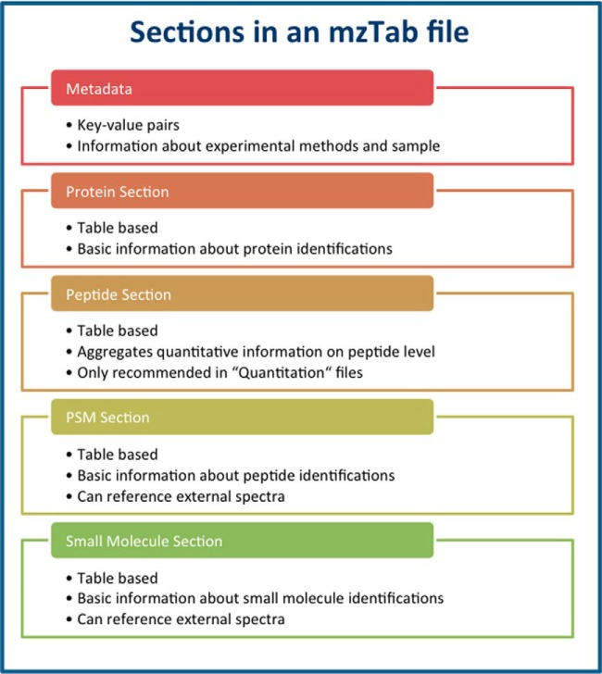
mzTab

Slide 47
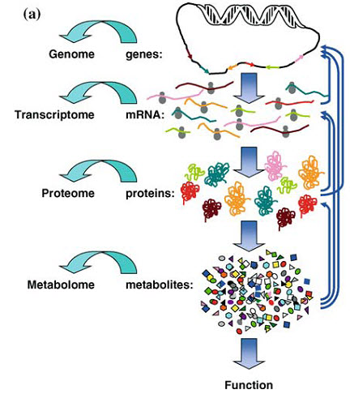
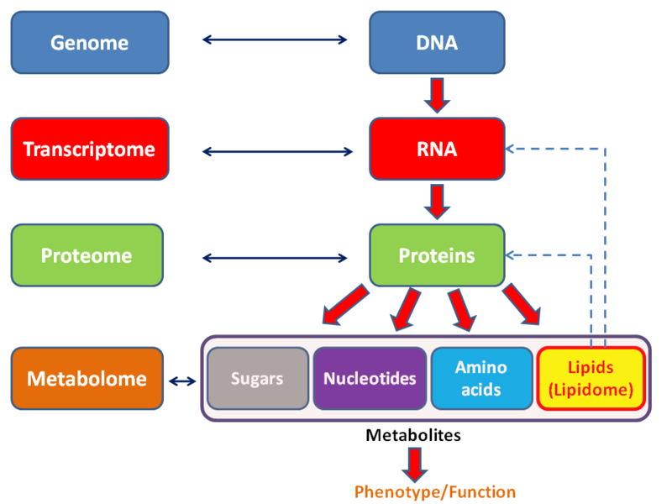

Slide 48
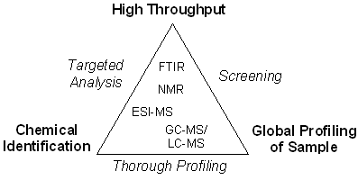
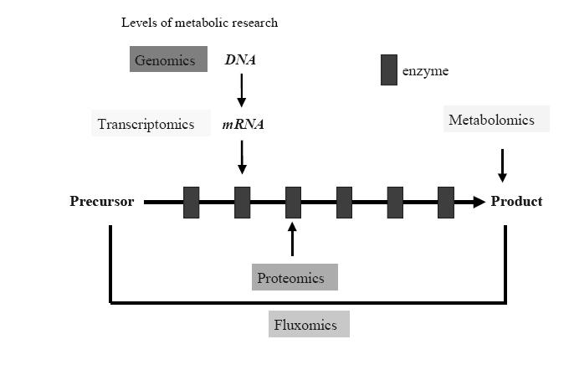

Slide 49
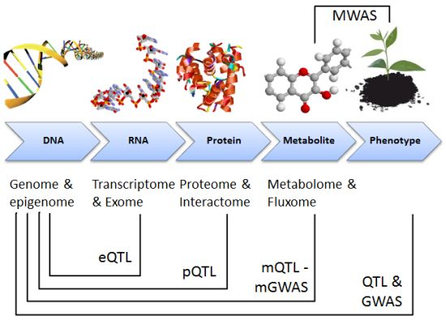

Slide 50
